Slide 1
CS:GO player engagement analysis
William Keilsohn

Slide 2

CS; GO is a massively popular online game
CS; GO
Counter Strike; Global Offensive
Online first person shooter focusing on team vs. team interactions
Matches or games
15 – 30 rounds
Teams composed of 5 – 15 players
Competitive and casual modes.
Notes:
Image source – 1
Information Source – 7

Slide 3
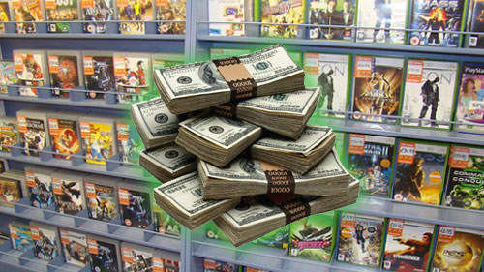
Video games are a multi-billion dollar industry
Fortnight = $2.4 Billion
MineCraft = Upwards of several billion.
Notch = $2.5 Billion
EA = $4 Billion
Kadokawa (owns FromSoftware) = $1.18 Billion
Valve = $4 Billion
Notes:
Image Source – 2
Information Source – 1, 2, 3, 4, 5

Slide 4

CS:GO is a model system for Video game analysis
Few/simple play modes.
Large and dedicated community.
Massively popular.
Approximately 2.5 million copies sold and 300k active players at any given time.
Common mode(s) follow easy to code/understand parameters.
Allow for effective data interpretation.
Notes:
Image Source – 4
Sources 7, 8

Slide 5
Central Questions
How are players interacting with each other in the game?
What are the best weapons?
What is the preferred bomb site?
Does round number affect weapon choice?
Does the game prefer one team over another?
Does map affect player performance?

Slide 6
Hypotheses
Round number does impact weapon used by player.
Round number does NOT impact team/player performance.
There is a preferred bomb site.
It is bomb site B.
Map has NO effect on player performance.

Slide 7
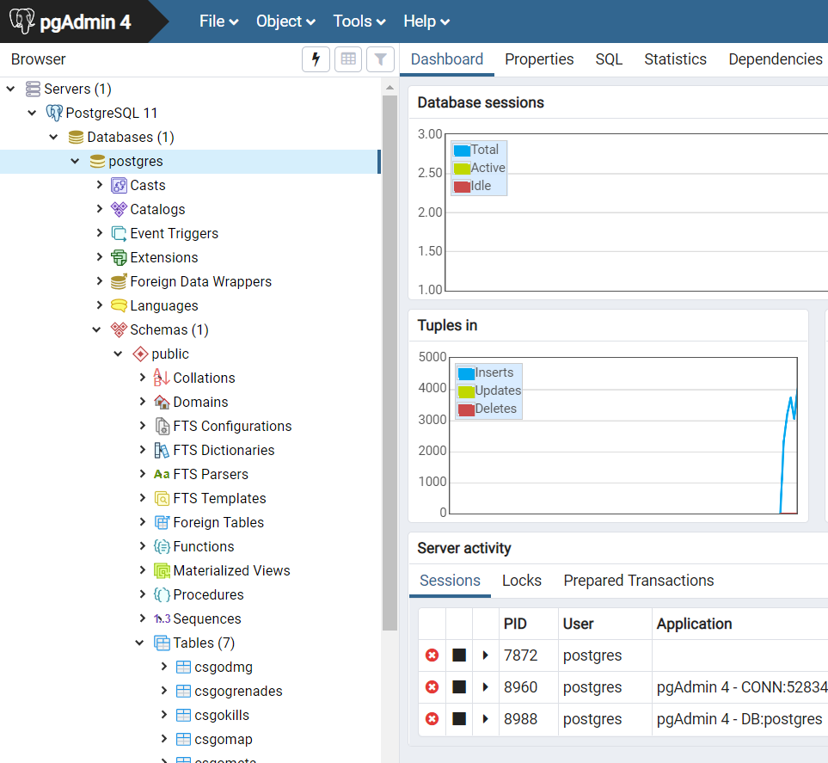
Data Obtainment and Handling
Data was obtained from Kaggle
https://www.kaggle.com/skihikingkevin/csgo-matchmaking-damage
Downloaded as several large csv files.
Imported into a PostgreSQL database
pgAdmin 4 used to improve data visualization.
Notes:
Image comes from my machine.

Slide 8
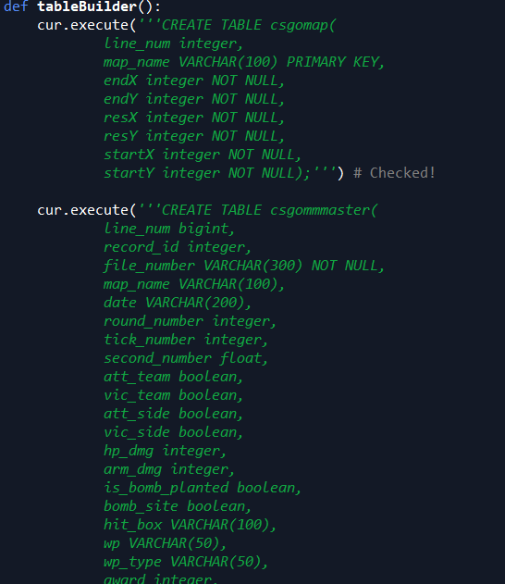
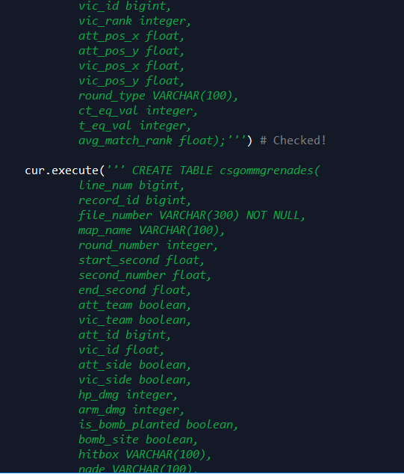
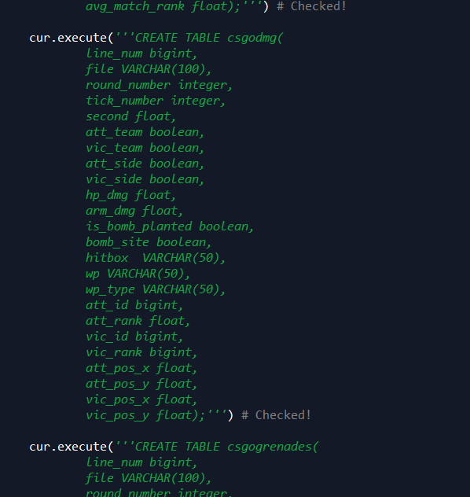
Data Structure
Following Data Tables:
Maps
Grenade Kills
Regular Weapon Kills
Meta data about players.
Each kill includes information about:
Weapon
Killer
Victim
Damage done
Notes:
Images are from my code.

Slide 9
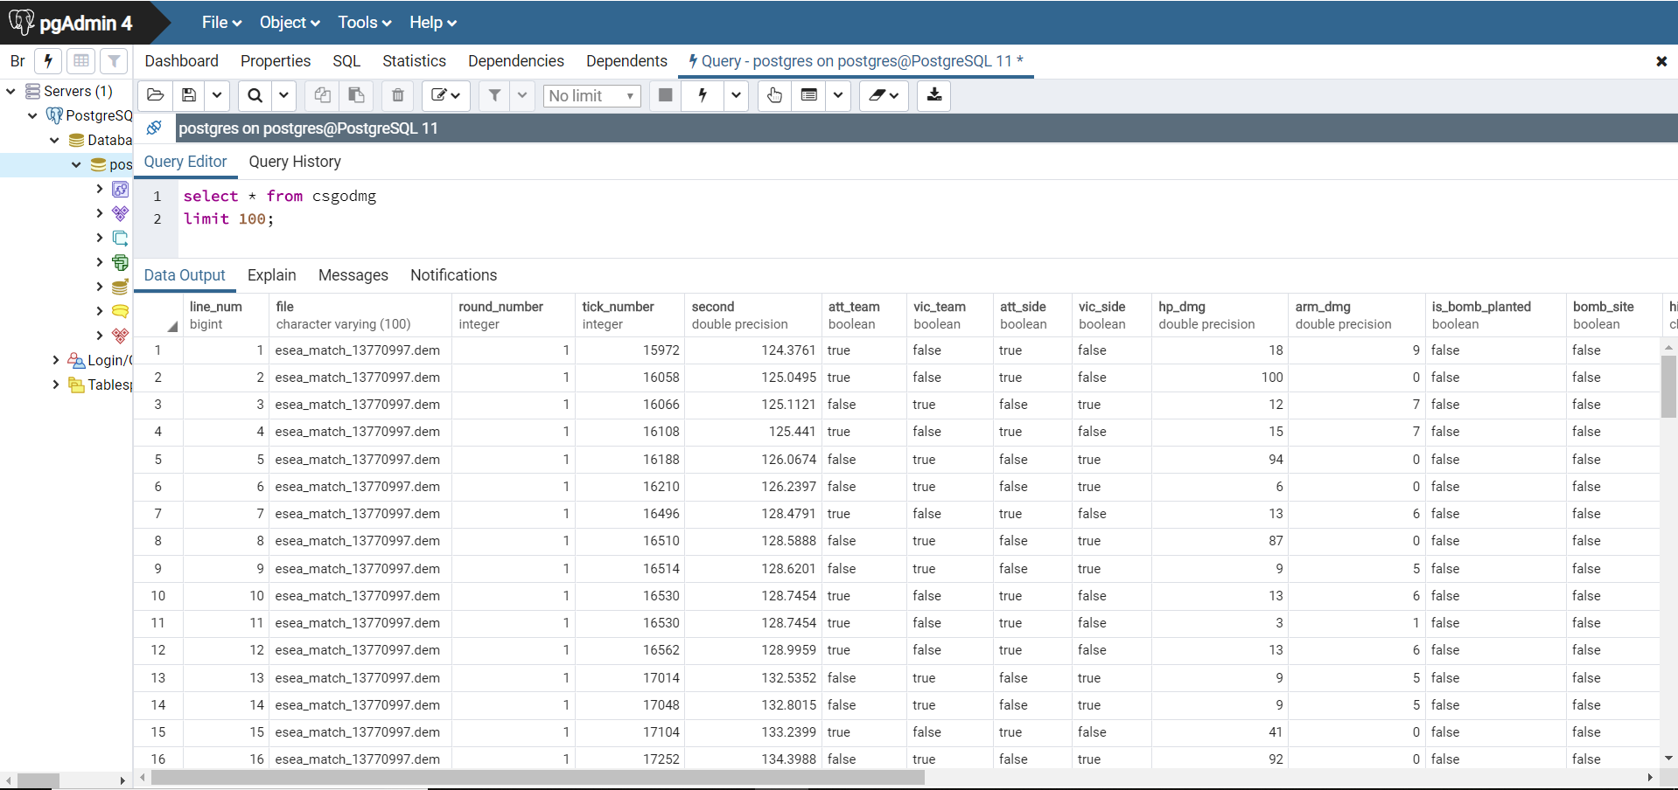
Notes:
Image is a screenshot from my machine.

Slide 10
Variables
Independent
Dependent
Round Number
Weapon Type
Grenade Type
Team
Hit Box
Weapon Type
Damage
Number of Kills
Bomb site
Player funds

Slide 11


Data manipulation and Handling
Anaconda:
Spyder
Packages:
Numpy
Pandas
Tkinter
PIL
Warnings
Random
Datetime
Seaborn
Psycopg2
Scipy
Statsmodels
Notes:
Image sources 8 -

Slide 12
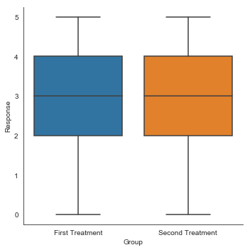
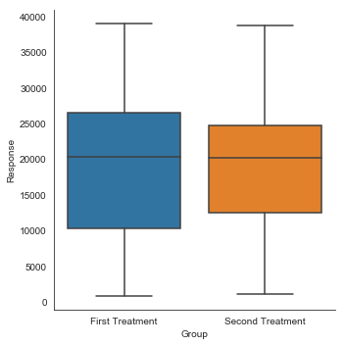
Results: Team Performance
Wilcoxon:
Stat = 69
P-value = 0.00077
Wilcoxon:
Stat = 111
P-value = 0.01245
T-test:
T-score = 0.2804
P-value = 0.780
T-test:
T-score = 0.198
P-value = 0.8433
Notes:
Image produced in python.

Slide 13
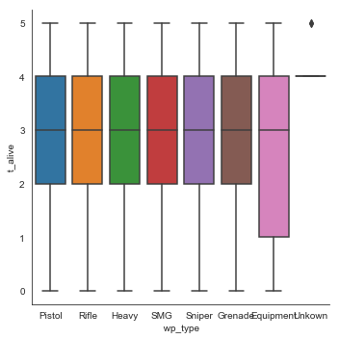
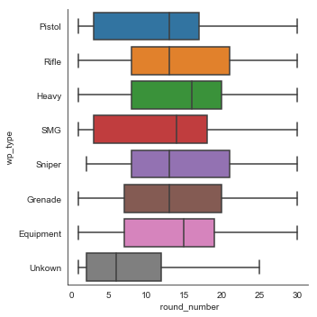
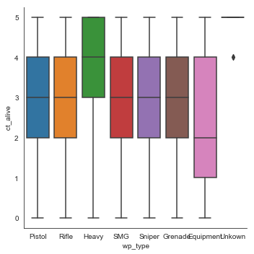
Results: Weapon Use over Time
ANOVA:
F-Stat = 3422
P-value = 0.0
ANOVA:
F-Stat = 553
P-value = 0.0
Chi-Square Test
P-value: 0.0
Notes:
Image produced in python.

Slide 14
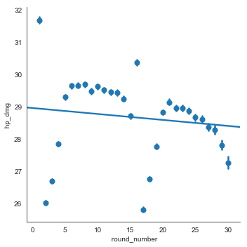
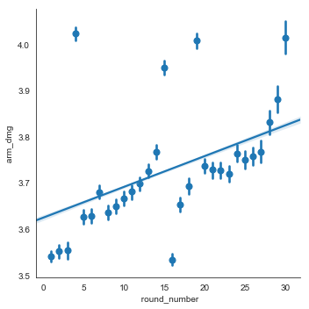
Results: Damage over time
Correlation:
P-value = 3.9573 * e^-77
Regression:
R² = 3.32 * e^-0.5
P-value = 3.9573 * e^-77
Correlation:
P-value = 1.8728 * e^-247
Regression:
R² = 0.000108
P-value = 1.8728 * e^-247
Notes:
Image produced in python.

Slide 15
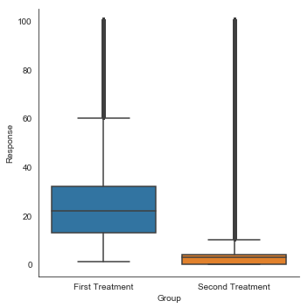
Results: Damage Type
Wilcoxon Test:
Stat = 0.0
P-value = 1.73 * e^-6
Indicates that players generally take more damage than their armor.

Slide 16
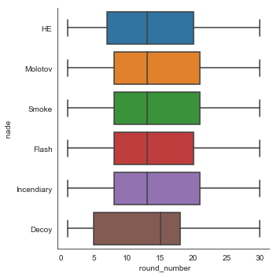
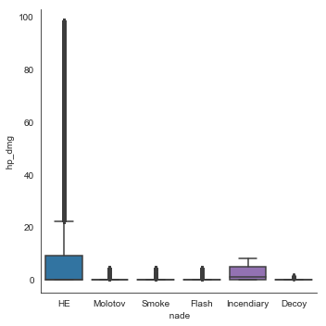

Results: Grenade use over time
ANOVA:
F-stat = 211877
P-value = 0.0
Chi-Square:
P-value = 0.0
Notes:
P-value ~ 0.001 for tukey post-hoc

Slide 17
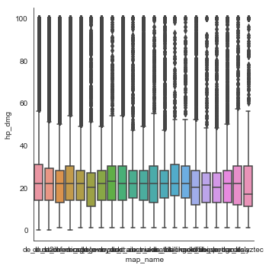
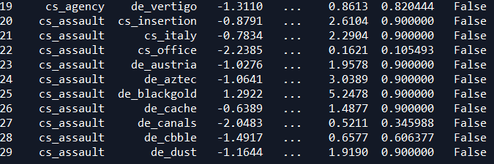
Results: Player Performance per Map
ANOVA:
F-Stat: 66.79
P-value: 9.96 * e^-271
Tukey’s Test indicates maps within game modes were not statistically different.
p >= 0.05
Indicated that there is a difference in game mode but not a difference in map within game modes.
Notes:
Image produced in python.

Slide 18
But Wait… What about Rushing B?

Slide 19
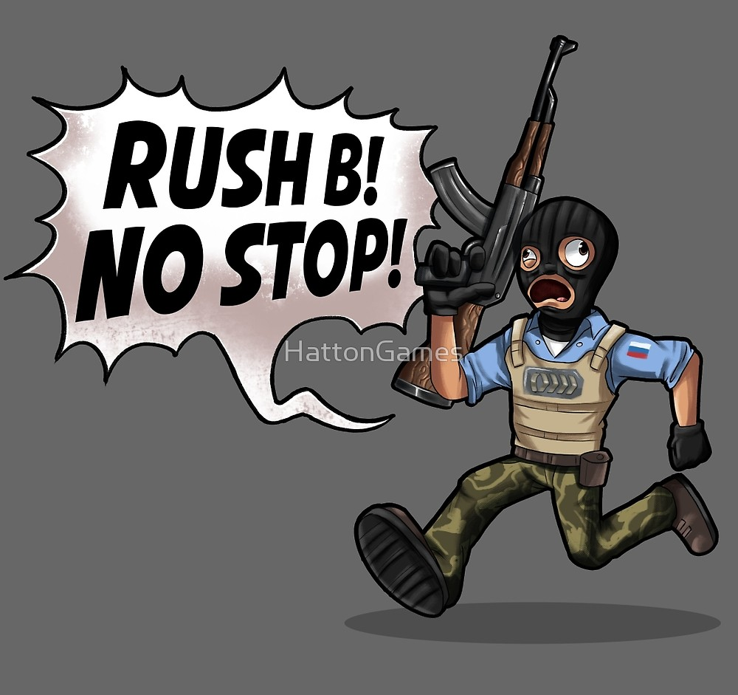
Don’t be a Noob
Bomb sites are labeled A and B
Community Believes that Site B is inherently better
Players on the terrorist team are told to “rush B” at the start of each round
Refers to the strategy by which the entire team quickly heads to the site in an attempt to overwhelm the enemy team.
Notes:
Image citation 8

Slide 20
And Now for a Demo
Notes:
2->2->8

Slide 21
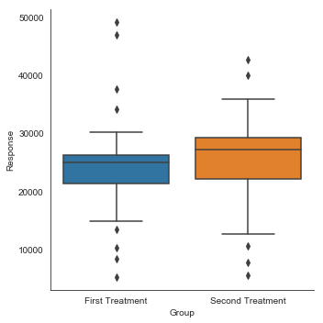
Results: Bomb Site Preference
Wilcoxon:
P-value = 0.00468
Site B is preferred over Site A
Doesn’t say much about success rate
Large number of outliers

Slide 22
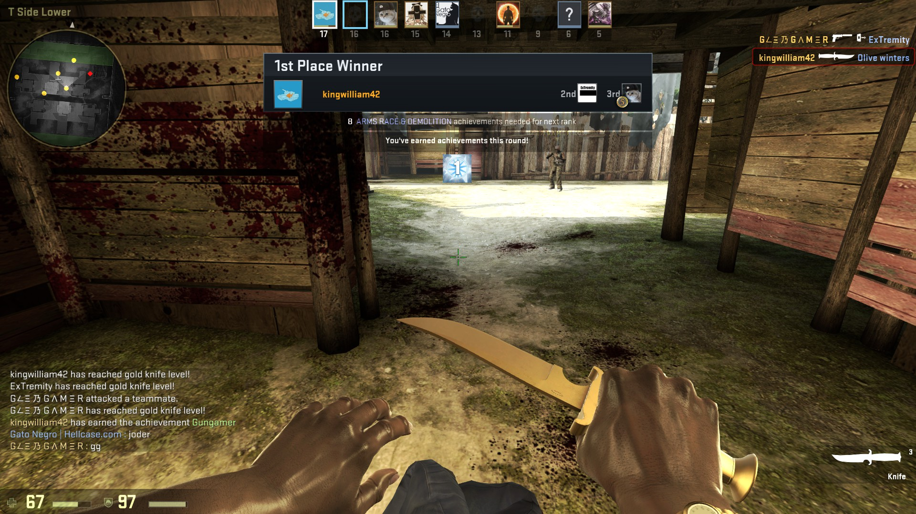
Limitations/Set Backs
Multiple tables
Difficult to keep track of variables
Redundancy in tables
Large Data
Time to upload to the database
Format of the data was inconsistent
Time
Notes:
Image provided by my steam profile:
https://steamcommunity.com/profiles/76561198028643470/screenshots/

Slide 23
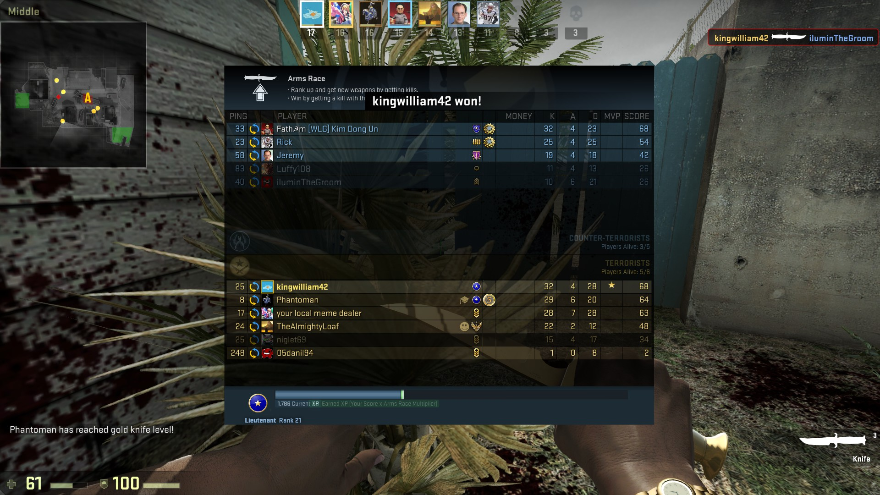
Future Directions
Player rank calculations
Machine learning
Focus more on players
What makes one successful?
What makes a good play?
How do you get better?
Focus on P-v-P interactions.
Increase user friendliness.
Notes:
Image provided by my steam profile:
https://steamcommunity.com/profiles/76561198028643470/screenshots/

Slide 24
Conclusions
Teams are fairly well balanced
There is no clear advantage/disadvantage between being on a particular side and how well one performs in game
As rounds progress players user larger/heavier weapons
As a result damage output increases
Players have a clear preference for heavy weaponry.
Additionally, only a select amount of equipment is utilized when interacting with other players.

Slide 25
Conclusions
Weapons do damage proportional to their programing
Players aren’t able to get “cheap” kills off of smaller caliber weapons
Similar to grenades
Game mode influences player performance.
However map within game mode does not influence player performance.
Skill is the major factor in player performance.

Slide 26
Rush B!
…If you’re CT…

Slide 27
Questions?
Notes:
Image Source – 6

Slide 28
References:
Literature
Images
https://www.dexerto.com/fortnite/how-much-money-did-fortnite-make-in-2018-285995
https://venturebeat.com/2013/02/01/minecrafts-notch-on-earning-101m-in-2012-its-weird-as-f/
https://www.recode.net/2014/9/9/11630712/game-on-why-microsofts-2-5-billion-minecraft-deal-could-be-a-steal
https://www.nasdaq.com/symbol/ea/financials?query=income-statement
http://info.kadokawadwango.co.jp/english/index.html
https://www.forbes.com/profile/gabe-newell/
https://store.steampowered.com/app/730/CounterStrike_Global_Offensive/
https://www.beyond2015.org/how-many-people-play-csgo/
https://www.gamopo.com/is-csgo-dying/
https://rdinvesting.com/market-commentary/release/electronic-arts-thriving-as-gaming-industry-shifts-focus-to-digital/
https://steamuserimages-a.akamaihd.net/ugc/931550995441646558/5E7385CA035C092EE1E2C0295298B5497494A800/?imw=512&imh=512&ima=fit&impolicy=Letterbox&imcolor=%23000000&letterbox=true
http://media.steampowered.com/apps/csgo/blog/images/fb_image.png?v=5
https://steamcdn-a.akamaihd.net/steam/apps/730/ss_ccc4ce6edd4c454b6ce7b0757e633b63aa93921d.1920x1080.jpg?t=1550873343
https://www.pinclipart.com/pindetail/oJhbJi_anaconda-python-logo-clipart/
https://en.wikipedia.org/wiki/Spyder_(software)#/media/File:Spyder_logo.svg
https://knowyourmeme.com/memes/rush-b

